Slide 1
SOUTH AFRICA
Language, Food and Culture

Slide 2


ZULU LANGUAGE
Useful phrases to practice before you travel to South Africa
Sawubona (sah-woo-BOH-nah)
Meaning: Hello / I see you
Used when greeting one person. Shows respect and acknowledgment.
Sanibonani (sah-nee-boh-NAH-nee)
Meaning: Hello (to multiple people)
Plural form of greeting - use when addressing a group.
Hamba kahle (HAHM-bah KAH-shleh)
Meaning: Go well / Goodbye (to someone leaving)
Traditional way to say farewell to someone departing.
Unjani? (oon-JAH-nee)
Meaning: How are you?
Polite way to ask about someone's wellbeing.
Ngiyaphila (ng-gee-yah-PEE-lah)
Meaning: I'm well / fine
Common response to "Unjani?"
Ngiyabonga (ng-gee-yah-BOHN-gah)
Meaning: Thank you
Shows appreciation and gratitude or acknowledgment.
Yebo (YEH-boh)
Meaning: Yes
Simple and commonly used in everyday conversation.
Cha (chah)
Meaning: No
Short and direct way to decline or disagree.
Learn Zulu with

Slide 3
XHOSA LANGUAGE
Useful phrases to practice before you travel to South Africa
Molo (MOH-loh)
Meaning: Hello
Used when greeting one person. Shows respect and acknowledgment.
Hamba kakuhle (HAHM-bah kah-KOO-hleh)
Meaning: Goodbye (to someone leaving)
Traditional way to say farewell to someone departing.
Unjani? (oon-JAH-nee)
Meaning: How are you?
Polite way to ask about someone's wellbeing.
Ndiyaphila (NDEE-yah-PEE-lah)
Meaning: I'm well / fine
Common response to "Unjani?"
Enkosi (EN-koh-see)
Meaning: Thank you
Shows appreciation and gratitude or acknowledgment.
Ewe (Yeh-weh)
Meaning: Yes
Simple and commonly used in everyday conversation.
Hayi (HAH-yee)
Meaning: No
Short and direct way to decline or disagree.
Learn Xhosa with Learn 101

Slide 4
AFRIKAANS LANGUAGE
Useful phrases to practice before you travel to South Africa
Hallo (HAH-loh)
Meaning: Hello
Used when greeting one person. Shows respect and acknowledgment.
Totsiens (TOT-seens)
Meaning: Goodbye (to someone leaving)
Traditional way to say farewell to someone departing.
Hoe gaan dit? (HOO-ghaan dit)
Meaning: How are you?
Polite way to ask about someone's wellbeing.
Dit gaan goed (Dit-ghaan ghoot)
Meaning: I'm fine / well
Common response to "Hoe gaan dit?"
Dankie (DAHN-kee)
Meaning: Thank you
Shows appreciation and gratitude or acknowledgment.
Ja (Yah)
Meaning: Yes
Simple and commonly used in everyday conversation.
Nee (NEH)
Meaning: No
Short and direct way to decline or disagree.
Learn Afrikaan with Easy Afrikaans

Slide 5
SOUTH AFRICAN ‘SLANGUAGE’
Every day (colloquial) language used in South Africa
Howsit!
Meaning: How are you? / Hi
Use: “Howzit, are you well?”
Lekker
Meaning: Nice, great, delicious, enjoyable
Use: “That was a lekker meal”
Chommie / China
Meaning: Friend / buddy
Use: “Thanks chommie.”
Now now
Meaning: Soon, in a little while (sooner than ‘just now’)
Use: “I’ll send the email now now.”
Just now
Meaning: Later, at an unspecified time
Use: “I’ll do it just now.”
Boma
Meaning: A communal outdoor dining area centred around a fire pit.
Use: “We’re having a braai at the boma tonight.”
Kwaai
Meaning: Cool, impressive, or tough.
Use: “That’s a kwaai new truck.”
Eish
Meaning: Exclamation of surprise, frustration, or amazement.
Use: “Eish, traffic was bad this morning.”
Agg / Ag man
Meaning: Expression of frustration, sympathy, or emphasis.
Use: “Ag man, don’t worry about it.”

Slide 6
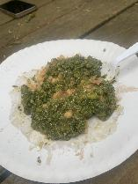
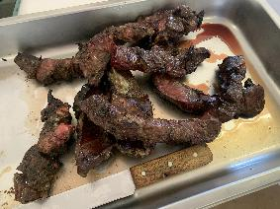
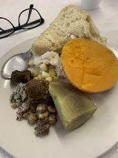
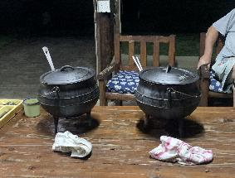
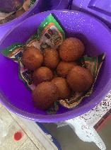
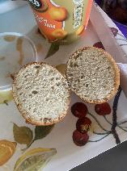
FOOD
Traditional South African Food you may experience
Braai
More than just a barbecue - it's a South African tradition! A social gathering where meat (boerewors sausages, lamb chops, chicken, steak) is grilled over wood or charcoal. September 24th is National Braai Day. It brings families and communities together.
Biltong
Dried, cured meat similar to beef jerky but with unique South African spices like coriander and vinegar. Made from beef, ostrich, or game meat. A popular snack and protein source that lasts for months without refrigeration.
Rusk
A traditional South African twice-baked biscuit, perfect for dipping into your morning coffee or rooibos (caffeine-free herbal tea) and a must-try for visitors wanting a taste of local home-style comfort.
Vetkoek
Deep-fried dough bread, similar to a doughnut but savory. Can be filled with curry mince, cheese, jam, or honey. The name means "fat cake" in Afrikaans. A popular comfort food and street snack.
Koeksister
A sweet treat! Plaited dough deep-fried and soaked in cold syrup, creating a crunchy outside and syrupy inside. Very sweet and sticky. A traditional Afrikaner dessert often enjoyed with tea or coffee.
Pap (or Mealie Pap)
A starchy porridge made from ground maize (corn). It's a staple food similar to polenta or grits. Can be served soft for breakfast or stiff as a side dish with meat and gravy. Often eaten with chakalaka or tomato relish.

Slide 7
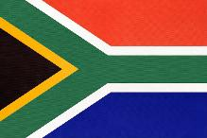
CULTURE
Cultural facts to help prepare for your trip of a lifetime!
The Rainbow Nation
South Africa is called the "Rainbow Nation" because of its diverse population. There are 11 official languages, including Zulu, Xhosa, Afrikaans, and English. This diversity comes from indigenous African people, European colonisation, and Asian immigration, creating a unique multicultural society.
Traditional Dress
Different ethnic groups have distinctive traditional clothing. Zulu people wear colourful beadwork with specific colour meanings (red = love, blue = faithfulness). Ndebele people are famous for brightly coloured geometric beadwork and blankets. Xhosa people wear bold black and white patterns with colourful embroidery.
Music & Dance
South African music is incredibly diverse. Genres include maskanda (Zulu guitar music), kwaito (house music variation), gqom (electronic dance), and mbaqanga (township jazz). Gumboot dancing originated in gold mines when miners created rhythms by slapping their boots. Each movement told stories of life and resistance.
Wildlife & Nature
South Africa is home to the "Big Five": lion, leopard, rhinoceros, elephant, and buffalo. The country has incredible biodiversity with unique ecosystems from deserts to coastlines. Kruger National Park is one of Africa's largest game reserves. Conservation is a major focus due to poaching threats.
Historical Significance
South Africa's history includes both triumphs and struggles. Apartheid (1948-1994) was a system of racial segregation that oppressed Black South Africans. Nelson Mandela, after 27 years in prison, became the first democratically elected president in 1994. His leadership emphasised reconciliation and forgiveness.
Modern South Africa
Today, South Africa is a constitutional democracy with one of the most progressive constitutions in the world. It's the most industrialised country in Africa and has a vibrant arts scene. Cities like Johannesburg, Cape Town, and Durban are cosmopolitan centres with world-class restaurants, galleries, and entertainment.

